Slide 1
Crypto Lending

Slide 2
Crypto Lending
What is Compound & how Compound works
Lending Protocols
How to play with Lending

Slide 3
Compound
Money markets
Interest rates based on the supply and demand of assets(floating interest rate)
Interest directly with the protocol

Slide 4
Collateral
Supplying/Deposit assets to protocol(借款人）
Earn interest, Supply APY
Compound allows users to borrow assets from the protocol（贷款人）
No terms to negotiate & No maturity dates & No Funding periods
Borrowing is instant
Borrowing cost is the floating interest rate
Pay interest, Borrow APY
The collateral used to borrow from the protocol is the deposited assets
Collateral factor, range from 0 to 1
Illiquid, small-cap assets have low collateral factors
liquid, high-cap assets have high collateral factors
SUM( USD(Asset) * collateral factors ) -> borrowing capacity

Slide 5
Interest rate model
Utilization ratio U = Borrows / (Cash + Borrows)
Borrowing Interest Rate = 2.5% + U * 20%
Supplier Interest Rate = Borrowing Interest Rate * U
over-collateralized

Slide 6
Use Case
Additional returns
Use Assets with no risk
Leverage
Short
Arbitrage

Slide 7
Liquidation
Incentives an ecosystem of arbitrageurs to quickly step in to reduce the borrower’s exposure
Eliminate the protocol’s risk
Liquidation discount ( Liquidation Threshold Rate)
Close Factor

Slide 8
Liquidation Example
Example：
1. The price of ETH : 1000U, collateral factor : 80%, liquidation discount : 10%, close factor: 25%
2. User deposit assert into protocol : 2ETH
3. Borrowing capacity : 2ETH * 80% * 1000U = 1600U
4. User borrowed : 1600U
ETH price down:
Liquidator supply : 1600U * 25% = 400U
Liquidator get : 400U/(1000U*90%) ~ 0.44ETH. Value is 0.44ETH * 1000U = 440U
New collateral: 1.56ETH
New borrowing capacity : 1.56ETH * 80% * 1000U = 1248U
New Borrow value : 1600U - 400U = 1200U
ETH price up to 2000U :
New Borrowing capacity : 2ETH * 2000U * 80% = 3200U, user can withdraw 1ETH

Slide 9
Liquidation scenarios
The interest
The price of the collateral drops
The price of the borrowed asset shoots up

Slide 10
cToken
ETH : underlying asset
cETH: cToken, shares of the pool, yield-token
Init: User A deposit 1000ETH to pool, Mint 1000cETH to User A
ETH in Pool : 1000
User A shares : 1000cETH / 1000cETH = 100%
1 cToken = 1 Underlying token
ETH is borrowed by someone and payed interest 1ETH. Now
ETH in Pool: 1001
User A shares : 100%
1 cToken = 1.001 Underly token
User B deposit 1000ETH to pool, Mint (1000ETH/1001ETH) * 1000cETH = 999.001cETH. Now
ETH in Pool: 2001
User A shares: 1000cETH / 1999.001cETH.
1 cToken = 1.001 Underly token

Slide 11
Price Oracle
Borrowing capacity
Liquidation

Slide 12
Compound
Only on Ethereum
Over-collateral
A portion of the interest paid by the borrower will go to its reserve

Slide 13
MakerDao
Over-collateral CDP
Dai - decentralized stablecoin pegged to USD
Borrowers pay the stability fee.

Slide 14
AAVE
Rate switching: borrowers can switch between variable and stable interest rates.
Collateral Swap: Borrowers can swap their collateral for another asset.
Flash loans

Slide 15
Cream
long-tail, exotic DeFi assets.
Lenient asset onboarding strategy. Listed more assets than any other lending protocol.
Iron Bank, an uncollateralized lending service to whitelisted partners.
A portion of the interest paid from the borrowers goes to reserve, distributed to CREAM token holders.

Slide 16
Liquidation
An liquidation example
https://etherscan.io/tx/0xb7ba825294f757f8b8b6303b2aef542bcaebc9cc0217ddfaf822200a00594ed9
https://etherscan.io/tx/0xa93bc349561d1f3d834b3c645864a3cb618be747ef4ec66d71c6a5512eeafff6
https://etherscan.io/tx/0xf63383b0891c2d9461626f64edb7fb747796ab09f6cd83d41bca0fafd72d445c
Compound-liquidator
https://chiragkhatri.me/compound-liquidator
Liquidation Dashboard
https://eigenphi.io/ethereum/liquidation

Slide 17
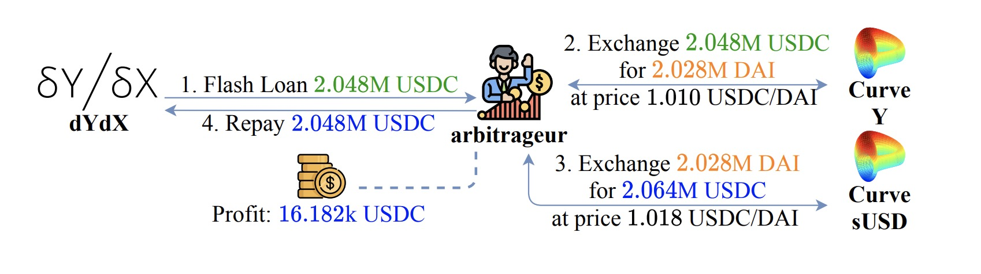
Flash Loan
Leverage nearly limitless capital
No collateral
Used for Arbitrage
https://etherscan.io/tx/0xf7498a2546c3d70f49d83a2a5476fd9dcb6518100b2a731294d0d7b9f79f754a
Used for liquidation
https://etherscan.io/tx/0xf63383b0891c2d9461626f64edb7fb747796ab09f6cd83d41bca0fafd72d445c

Slide 18
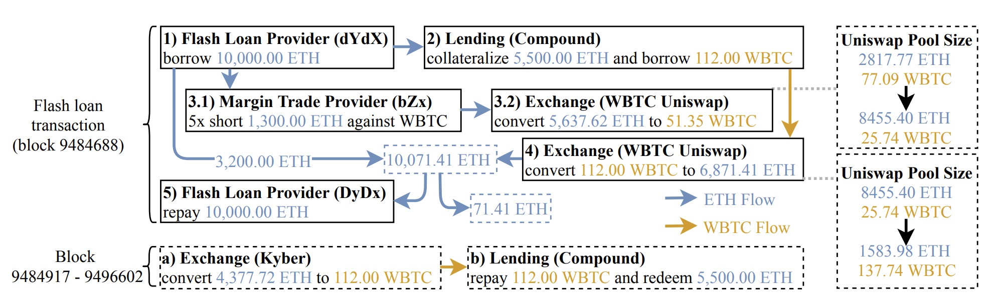
Flash Loan Exploits
https://etherscan.io/tx/0xb5c8bd9430b6cc87a0e2fe110ece6bf527fa4f170a4bc8cd032f768fc5219838

Slide 19
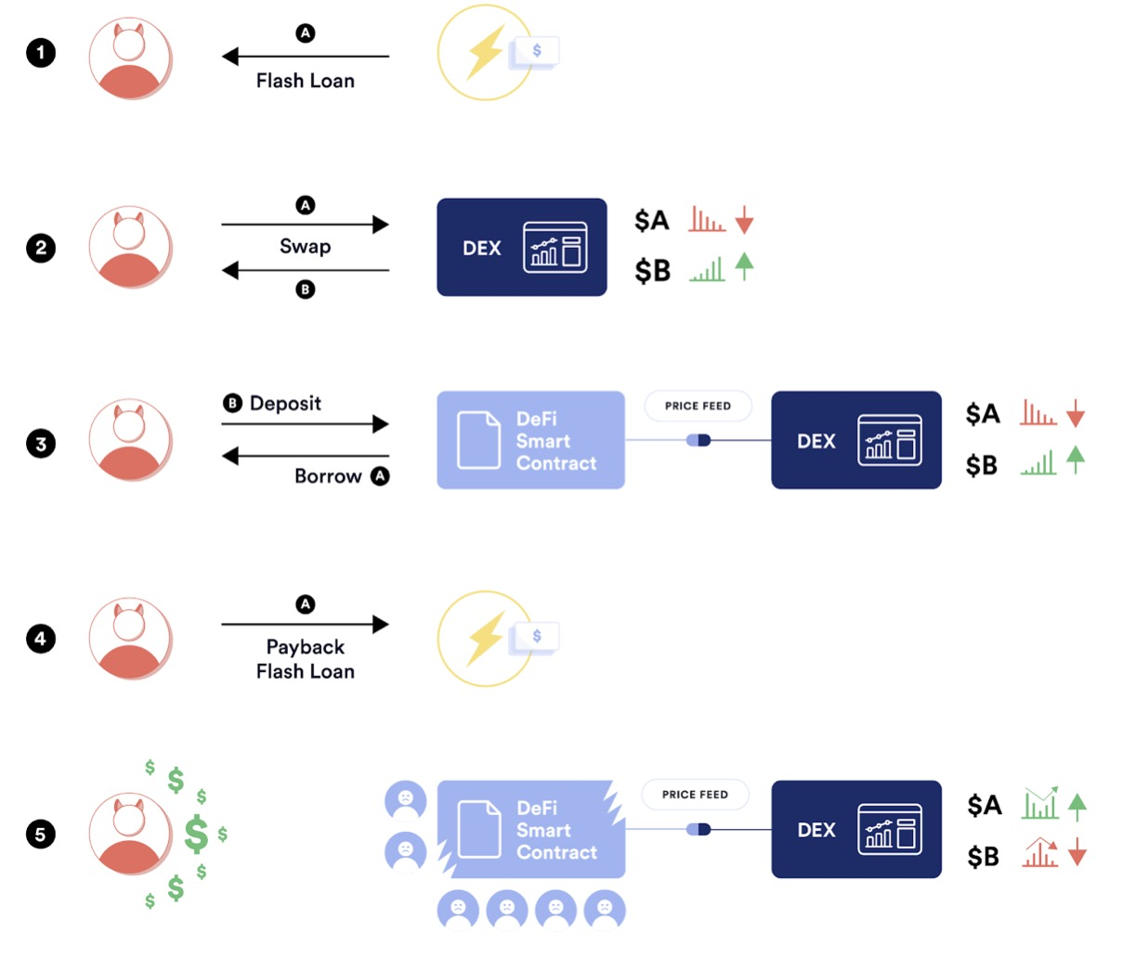
Price Oracle Attack

Slide 20
Price Oracle Attack
https://peckshield.medium.com/cheese-bank-incident-root-cause-analysis-d076bf87a1e7
LP asset price attack
https://medium.com/@AndyPavia/swissblock-post-mortem-cream-finance-hack-7c1caff4335c
LP asset price attack
https://blocksecteam.medium.com/price-oracle-manipulation-attack-on-inverse-finance-a5544218ea91
Asset price attack

